Slide 1


CSE 299
North South University

Slide 2

Group Introduction
Name | ID
Sayeed Miner | 1812137042
Mohammad Shaikhul Fuad | 1812080042
MD ZAHIDUL HAQUE | 1813028642

Slide 3

Tourist Guide
Project Topic

Slide 4

Outline
Introduction
Motivation
Beneficial
Different than existing solution
Features Implemented
Self Evaluation
Gannt Cart
Contributions
Future Improvements

Slide 5

Introduction
In our day to day life, we need some refreshment and adventure. People love to travel but sometimes they face some difficulties. Generally, when someone wants to travel, he needs to book transports, hotels etc which takes a lot of time. Our goal is to make travelling a lot easier for everyone. Our website is user friendly so anyone can easily understand its functionality.

Slide 6


Motivations
Not all websites can offer these functionalities
Face difficulties booking transports or guides
Deceived by conman, who disguise themselves as guides
Faces trouble to find food

Slide 7

How Our Project Might Be Beneficial?
All at one place
Relief Ness of Tourist
Payment is Handy
Restaurant near you
Providing Jobs - Guides

Slide 8

How Our Project is Different?
Existing – ShareTrip, Obokash, Tour.com.bd
Many Features
Guide Reservation
Promote Nearby Restaurants

Slide 9
Features Implemented
Sign in/Login
Dashboard
Packages
Reservation
Transport
Payment
Package Confirmation
Restaurant
Food Order
Profile
Update
Insert

Slide 10
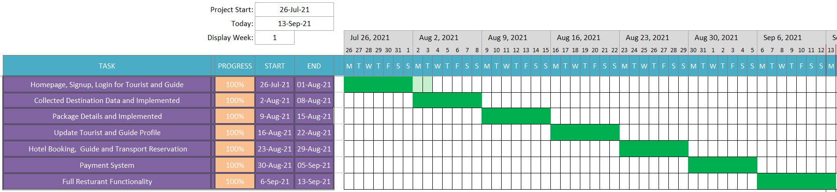
f
Seven Weeks Work
Figure: Gannt Chart

Slide 11
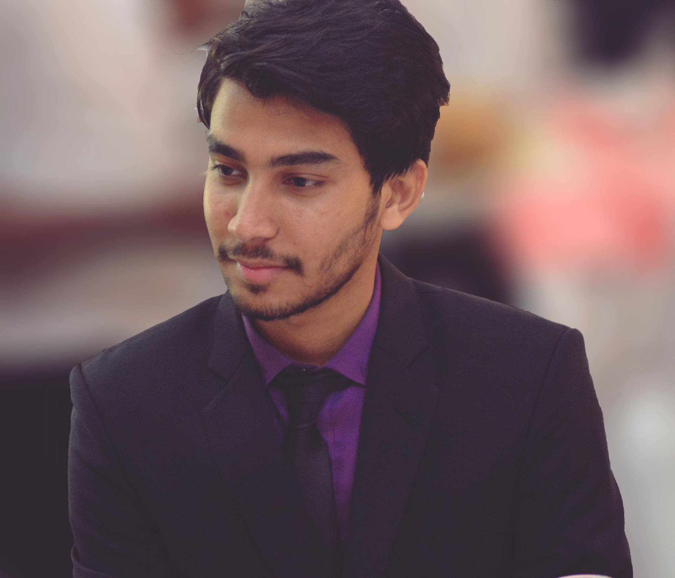
Contribution
Home Page (Frontend)
Signup
Places
Tourist Registration (Frontend + Backend)
Restaurant Login (Frontend + Backend)
Guide Profile Card (Frontend + Backend)
Edit Profile for Guide (Frontend + Backend)
Information fetched from Database
Data insertions and collections of city, packages, hotels and transportations
Booking history (Frontend + Backend)
Guide Dashboard (Frontend + Backend)
Footer
Shaikhul Fuad

Slide 12
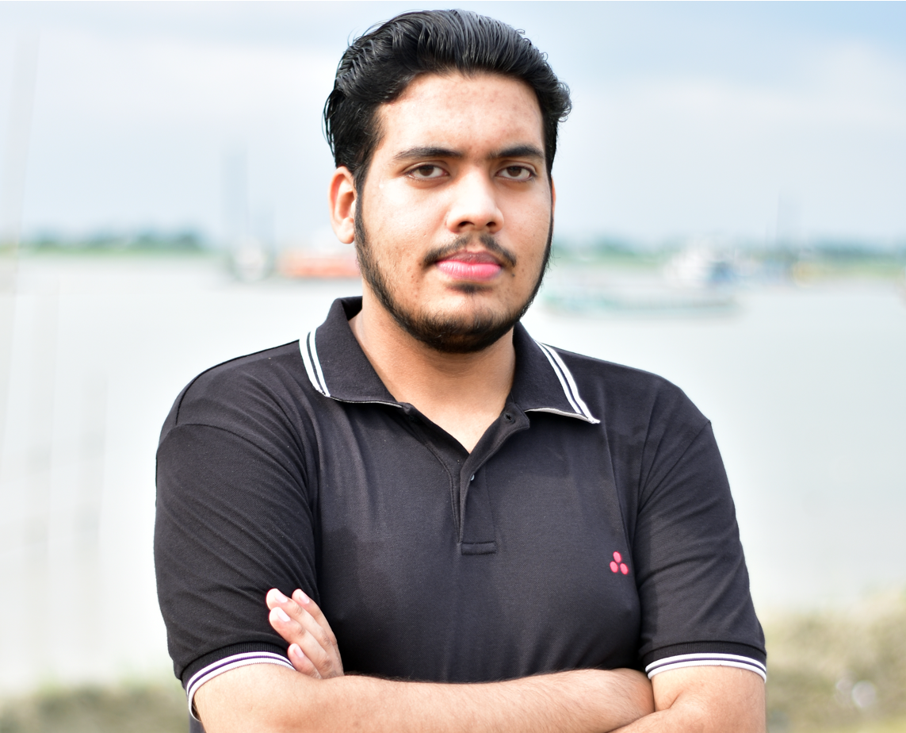
Contribution
Home Page (Frontend)
Functional Cards
Contact Info
Guide Registration (Frontend + Backend)
Tourist Login (Frontend + Backend)
Restaurant Profile Card (Frontend + Backend)
Edit Profile for Restaurant (Frontend + Backend)
Information fetched from Database
Data insertions and collections of packages, hotels, transportations
Payment (Frontend + Backend)
Restaurant Dashboard (Frontend + Backend)
Privacy
Sayeed Miner

Slide 13
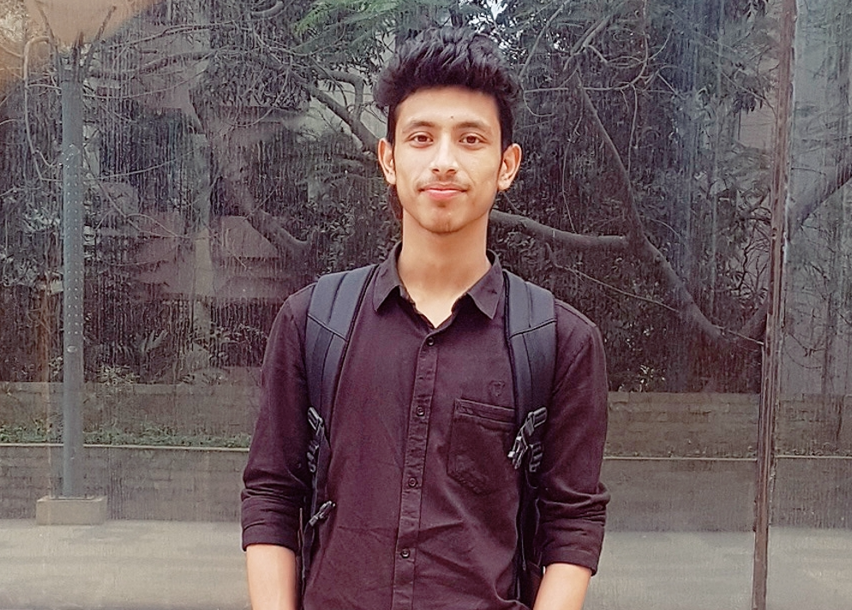
Contribution
Home Page (Frontend)
Login
Know us
Restaurant Registration (Frontend + Backend)
Guide Login (Frontend + Backend)
Tourist Profile Card (Frontend + Backend)
Edit Profile for Tourist (Frontend + Backend)
Information fetched from Database
Data insertions and collections of packages, hotels, transportations
Booking (Frontend + Backend)
Tourist Dashboard (Frontend + Backend)
Terms and condition
Md Zahidul Haque

Slide 14
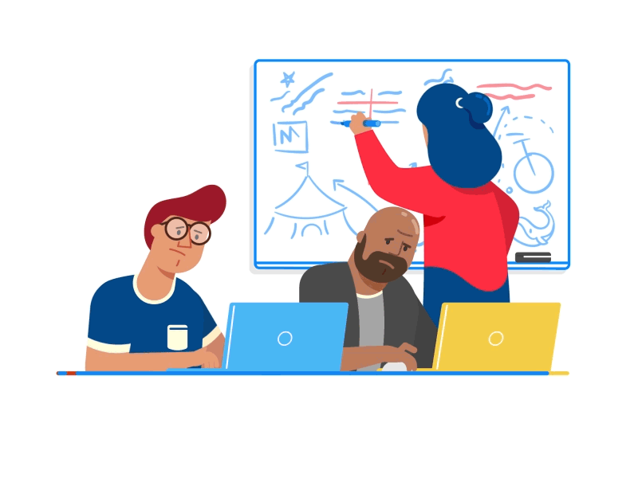
Future Improvements
Chat system
Google map
The mobile app

Slide 15


